Slide 1
Data Retrieval

Slide 2
Vector Store Retrieval Process
Retrieval Techniques
Vector Store vs Structure Database
LangChain Vector Store Retriever
Vector Store Search Parameters

Slide 3

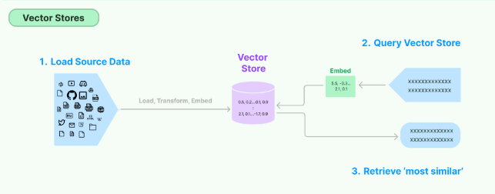

Slide 4
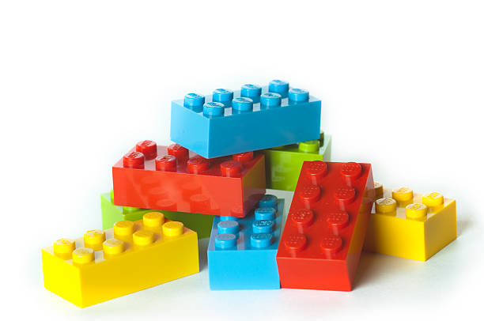
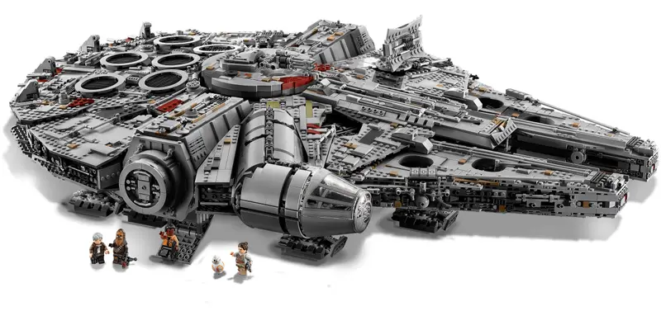
Vector Store Retrieval
Imagine you have a really big box of LEGO pieces, but instead of sorting them by color or size, you sort them by how similar they are to each other in shape and feel. A vector store is like that: it helps you find things that are similar based on their "meaning."
When you want to find something, you tell the vector store what you’re looking for, and it finds the pieces (or documents) that are most like what you asked for. It doesn't look for exact matches; instead, it looks for pieces that are close in meaning, like if you said, "Find something that looks like a spaceship." It would find all the LEGO pieces that could be used to build a spaceship, even if they aren’t exactly the same.

Slide 5


Similarity Search vs MMR Search
"Cat Breeds and Care" = [0.13, -0.42, 0.34, 0.92, -0.29, ...]
Similarity Search (Pure Relevance Search)
"cat" = [0.12, -0.45, 0.33, 0.98, -0.27, ..., 0.05]
"feline" = [0.11, -0.46, 0.31, 0.97, -0.25, ..., 0.04]
First result: "Cat" = closest to query.
Second result: "Feline" = very close but repetitive.
Third result: "Wild Cats" = still relevant but further away.
"Wild Cats" = [0.14, -0.40, 0.35, 0.90, -0.30, ...]
"car" = [0.89, -0.67, -0.23, 0.04, 0.76, ..., -0.15]
MMR Search (Balancing Relevance and Diversity)
First result: "Cat" = most relevant.
Second result: "Wild Cats" = still relevant but more diverse, adds broader information about cats.
Third result: "Cat Breeds and Care" = provides a distinct angle on cat breeds and care, enriching the search results.
Query embedding: "cat breeds" = [0.10, -0.44, 0.32, 0.95, -0.26, ...]

Slide 6
Aspect | Vector Store | SQL Database
Data Representation | Embeddings - high-dimensional vectors | Tabular form with rows and columns
Query Type | Similarity-based queries (e.g., cosine similarity, MMR) | SQL queries (e.g., exact matches, conditions)
Use Case | Unstructured data, NLP applications, semantic search | Structured data, transactional systems, reporting
Indexing and Retrieval Mechanism | Vector indexes like FAISS, Chroma, distance metrics (e.g., cosine similarity) | B-trees or hash indexes, exact value or range-based retrieval
Scalability | Handles large high-dimensional vectors, may require sharding | Well-established techniques for horizontal and vertical scaling
Complexity | Requires embedding model; retrieval based on approximate nearest neighbors | Easier setup; deterministic and precise retrieval
Flexibility | Flexible for unstructured and semi-structured data, generalization in searches | Limited to structured data; requires schema changes for new data types
Example Queries | Find articles similar to a text snippet (based on embeddings) | SELECT * FROM articles WHERE category = 'Technology';

Slide 7


Types of Retrieval Techniques
Vector Store Retrieval
Multiple Query Generation for Retrieval
Contextual Compression
Custom Retriever Classes
Similarity Score Integration
Combining Results from Multiple Retrievers
Reordering to Mitigate 'Lost in the Middle' Effect
Multiple Embeddings per Document
Chunk Retrieval for Complete Document Context
Metadata Filters
Time-Weighted Retrieval
Hybrid Vector and Keyword Retrieval

Slide 8
LangChain Vector Store Retriever
A vector store retriever is a retriever that uses a vector store to retrieve documents.
It is a lightweight wrapper around the vector store class to make it conform to the retriever interface.
It uses the search methods implemented by a vector store, like similarity search and MMR, to query the texts.

Slide 9
Creating a Retriever from a Vector Store
Previous lesson we created the vector store:
vectorstore = Chroma.from_documents(documents=splits, embedding=OpenAIEmbeddings())
Retriever defaults to Similarity Search
# Instantiate the Retriever: Create a retriever using the .as_retriever() method.
retriever = vectorstore.as_retriever()
# Usage
docs = retriever.invoke("what did the president say about ketanji brown jackson?")

Slide 10
Maximum Marginal Relevance Retrieval
Search Type Specification:
By default, the vector store retriever uses similarity search.
If supported by the underlying vector store, you can use Maximum Marginal Relevance (MMR).
# Example Code:
retriever = vectorstore.as_retriever(search_type="mmr")
docs = retriever.invoke("what did the president say about ketanji brown jackson?")

Slide 11
Search Parameters
Similarity Score Threshold Retrieval:
# Set a similarity score threshold to only return documents with a score above a specified threshold.
retriever = vectorstore.as_retriever(
search_type="similarity_score_threshold", search_kwargs={"score_threshold": 0.5}
)
docs = retriever.invoke("what did the president say about ketanji brown jackson?")
Specifying Top-K:
# Limit the number of documents returned by the retriever using top-k.
retriever = vectorstore.as_retriever(search_kwargs={"k": 1})
docs = retriever.invoke("what did the president say about ketanji brown jackson?")
len(docs)

Slide 12
Q&A

Slide 13
Class Diagram TODO

Slide 14
Coding Exercise
> <<Docker instructions>>
> cd Enterprise-LLM-RAG/lessons/04-data-retrieval

